Slide 1
1st Objective

Slide 2
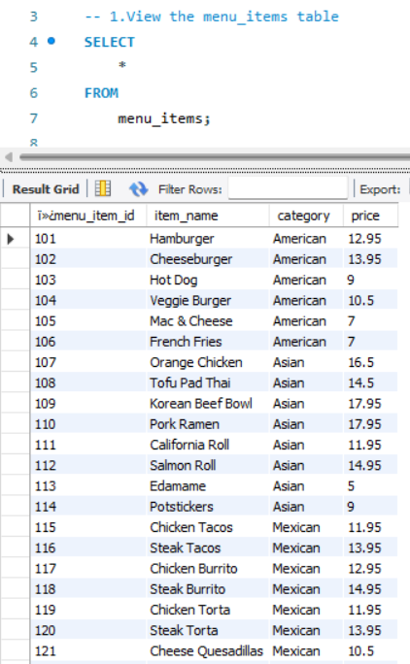
1.View the menu_items Table

Slide 3
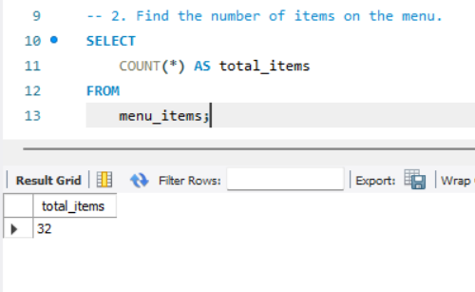
2. Find the number of items on the menu.

Slide 4
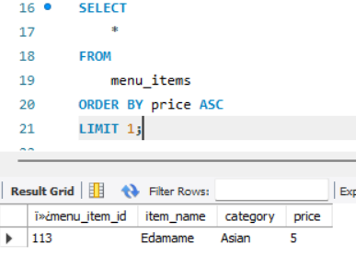
3. What are the least expensive items on the menu?

Slide 5
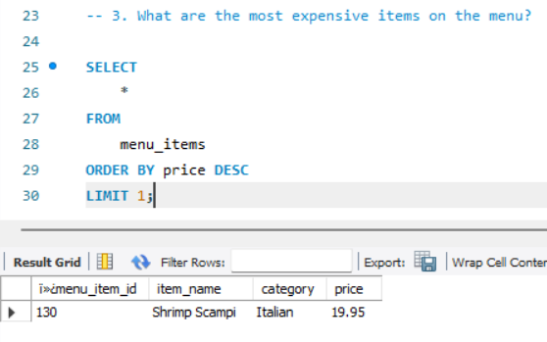
3. What are the most expensive items on the menu?

Slide 6
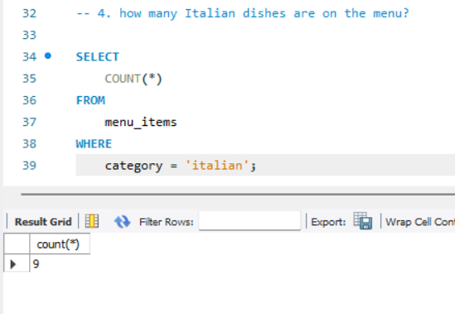
4. how many Italian dishes are on the menu?

Slide 7
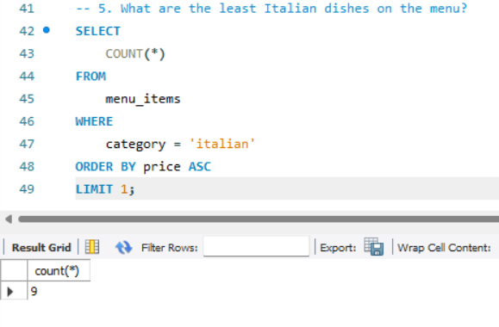
5. What are the least Italian dishes on the menu?

Slide 8
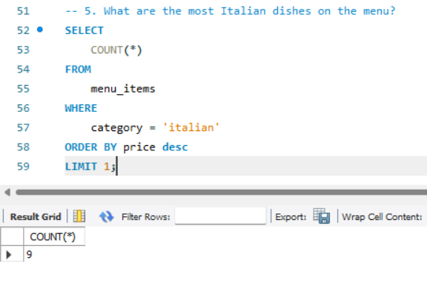
5. What are the most Italian dishes on the menu?

Slide 9
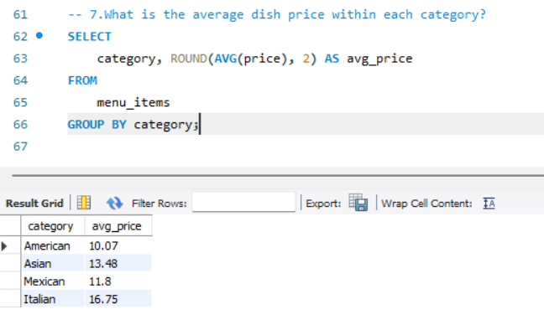
7.What is the average dish price within each category?

Slide 10
2nd Objective

Slide 11
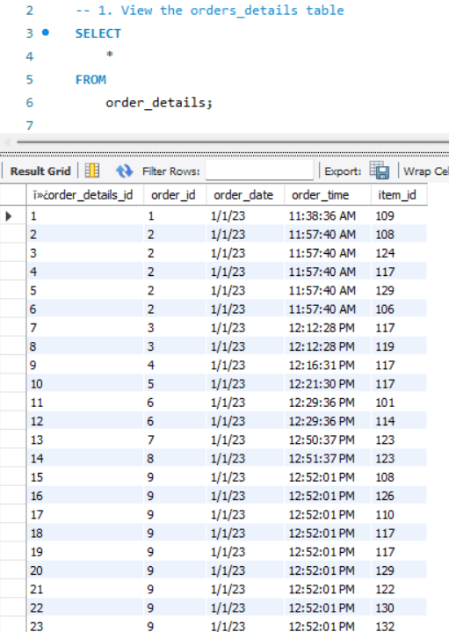
View the orders_details table

Slide 12
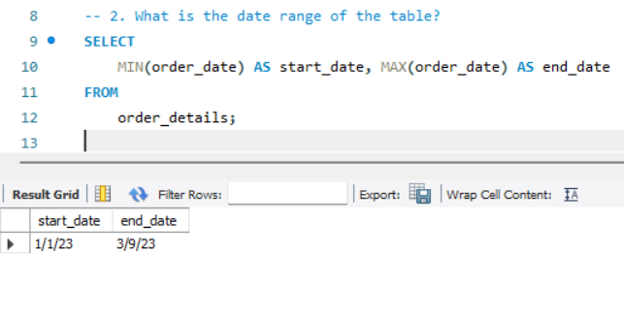
2. What is the date range of the table?

Slide 13
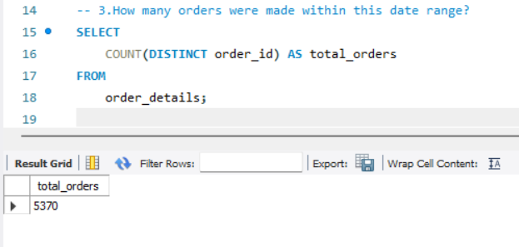
3.How many orders were made within this date range?

Slide 14
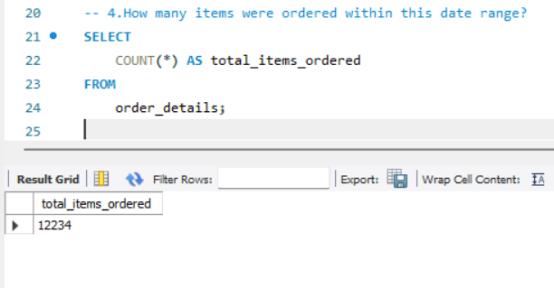
4.How many items were ordered within this date range?

Slide 15
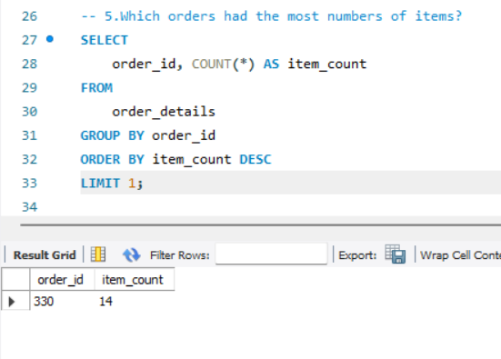
5.Which orders had the most numbers of items?

Slide 16
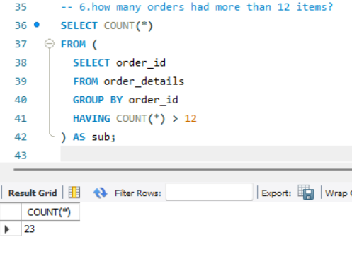
6.how many orders had more than 12 items?

Slide 17
3rd objective

Slide 18
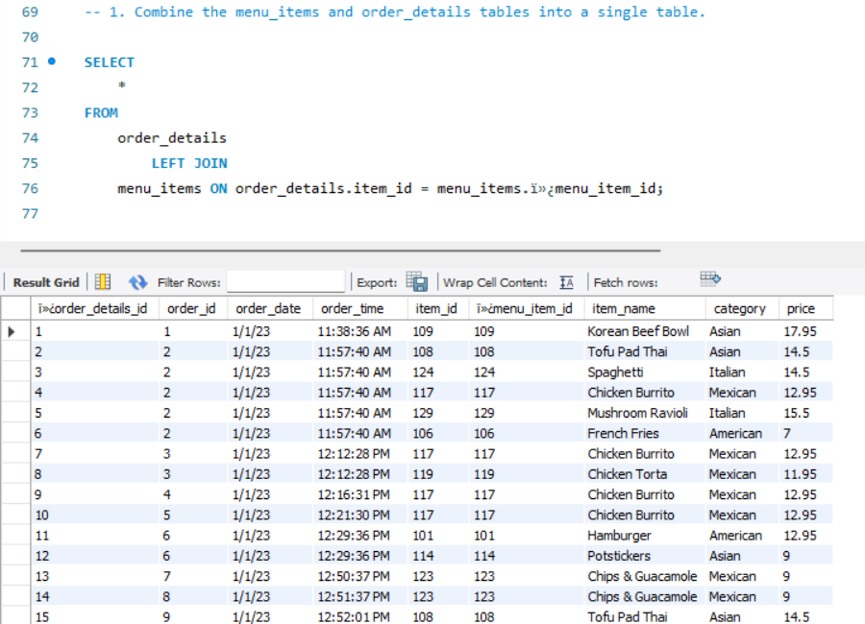
1. Combine the menu_items and order_details tables into a single table.

Slide 19
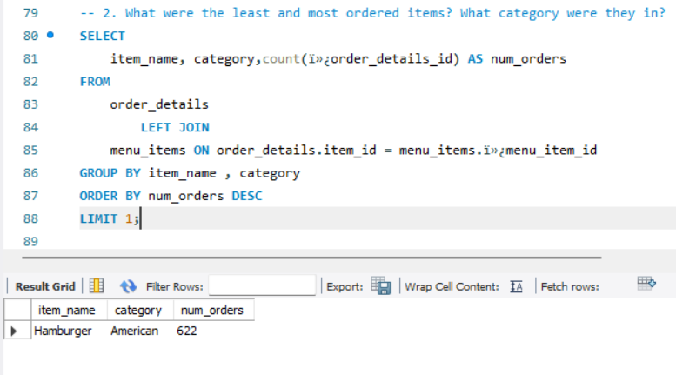
2. What were the least and most ordered items? What category were they in?

Slide 20
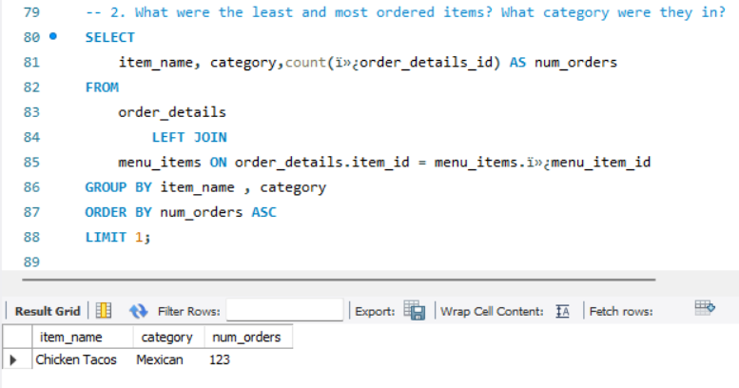

Slide 21
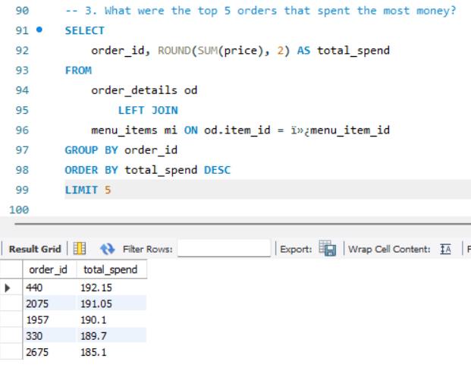
3. What were the top 5 orders that spent the most money?

Slide 22
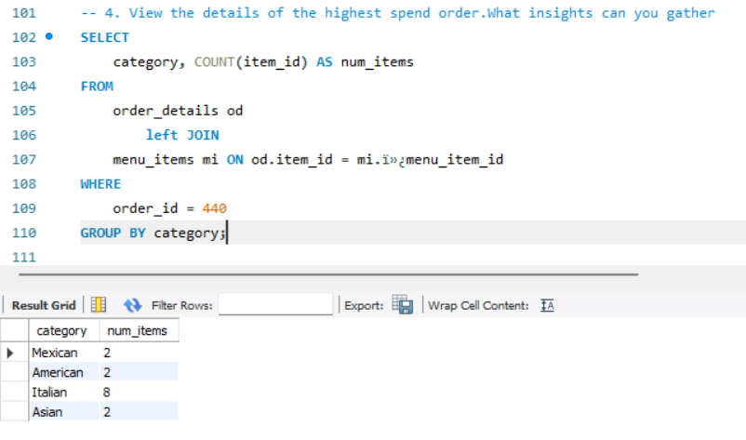
4. View the details of the highest spend order.What insights can you gather

Slide 23
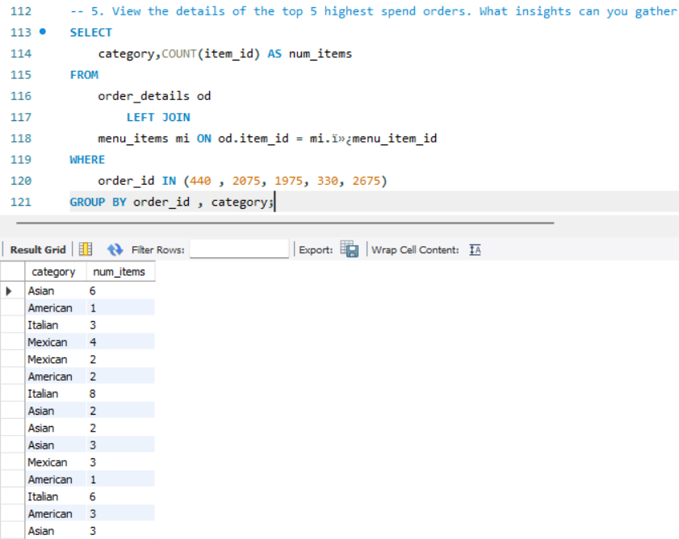
5. View the details of the top 5 highest spend orders. What insights can you gather

